Slide 1
Fibre Optic
Optical Cable

Slide 2
Fibre Optic
Fibre-optic cabling uses either glass or plastic fibres to guide light impulses from source to destination.
The bits are encoded on the fibre as light impulses.
Optical fibre cabling is capable of very large raw data bandwidth rates.
Most current transmission standards have yet to approach the potential bandwidth of this media.

Slide 3
Unlike copper wires….
Fibre-optic cable can transmit signals with less attenuation and is completely immune to EMI and RFI.
Fibre-optic cabling is now being used in four types of industry:

Slide 4
Enterprise Networks
FTTH and Access Networks
Long-Haul Networks
Submarine Networks

Slide 5
Enterprise Networks: Fibre is used for backbone cabling applications and interconnecting infrastructure devices.
FTTH and Access Networks: Fibre-to-the-home (FTTH) is used to provide always-on broadband services to homes and small businesses.
FTTH supports affordable high-speed Internet access, as well as telecommuting, telemedicine, and video on demand.

Slide 6
Long-Haul Networks: Service providers use long-haul terrestrial optical fibre networks to connect countries and cities.
Networks typically range from a few dozen to a few thousand kilo metres.
Submarine Networks: Special fibre cables are used to provide reliable high-speed, high-capacity solutions capable of or surviving in harsh undersea environments up to transoceanic distances.

Slide 7
Need for fibre..
Vastly increased requirement for transmission capacity.
Bandwidth is limited by carrier frequency:
Example;
Microwave ~ 10GHz
Optical carrier ~ 60 Tera bits per second.
Coaxial cable ~ 13,000 voice channels
Terrestrial microwave ~ 20,000 channels
Satellite link ~ 100,000 channels

Slide 8
Optical fibre link
~300,000 channels
~10,000,000 channels…
Capacity over a single link is incredible
Optical fibre link were;
~300,000 channels
~10,000,00
Capacity over a single link is incredible
Now a lot more!!

Slide 9
Japan demonstrated a single fibre cable that was able to transfer;
1 petabit per second (10¹⁵bits/s) over a distance of 50 kilometers.

Slide 10
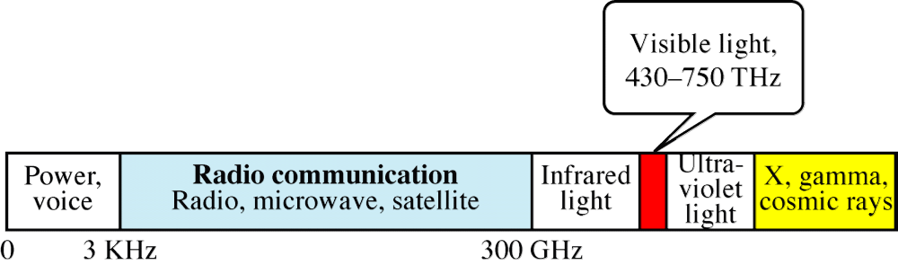
Electromagnetic Spectrum

Slide 11
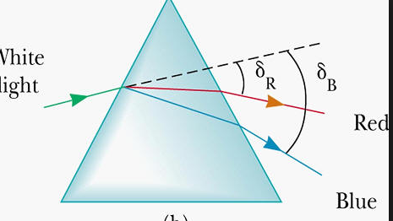
Wavelengths and Colour

Slide 12
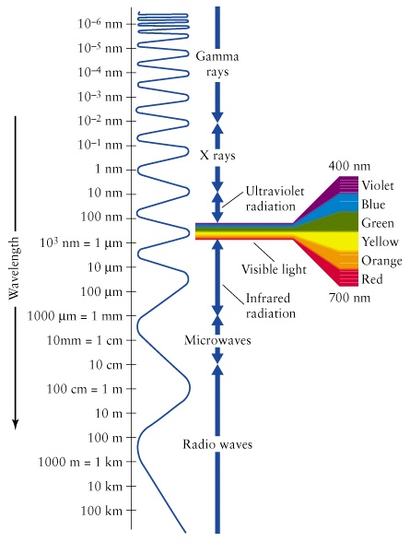
Different colours = Different Wavelengths

Slide 13
c = λf
Speed of light = wavelength x frequency

Slide 14
Made of glass or plastic
Transmits signals in the form of light
Light is a form of electromagnetic energy
Light travels Fastest in a vacuum
Travels at 300,000km/s 3x 10^8m/s
Speed depends on density of medium

Slide 15
The denser the medium the slower the speed.
Light travels faster in air than water.
Light travels faster in a vacuum than air.
Light is vibrating molecules.

Slide 16
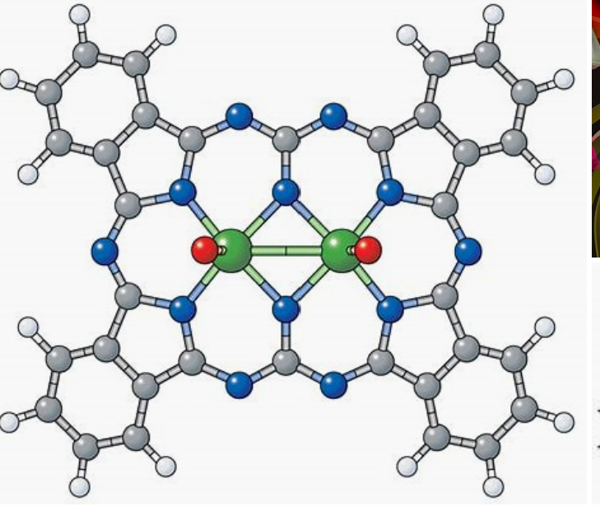
Structure of light

Slide 17
Light can either..
Reflect or ....
Refract

Slide 18
Refraction
If a ray of light is travelling through one substance and suddenly enters another more or less dense substance
Then it’s speed changes abruptly
Causing the ray to change direction
REFRACTION

Slide 19
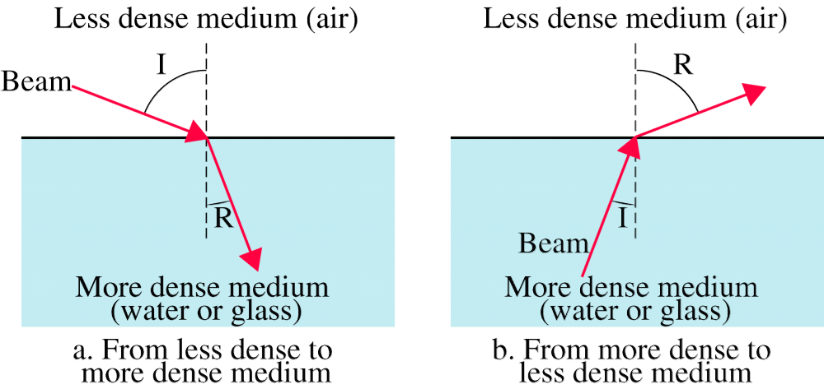
Refraction

Slide 20
Fibre optic technology takes advantage of this property
To control the propagation of light through the fibre channel
Critical angle:
Gradually increase the angle of incidence
Angle of refraction increases also…

Slide 21
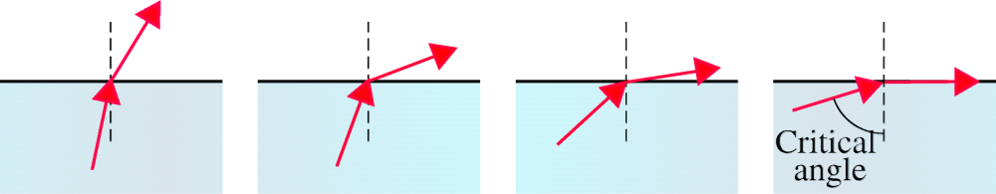
Figure 7-14
Critical Angle

Slide 22
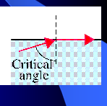
Eventually refracted beam lies along the horizontal
Angle of incidence = critical angle
Then what happens?????

Slide 23
Reflection
When angle of incidence > critical angle
Complete reflection
TIR
Light no longer passes into less dense medium

Slide 24
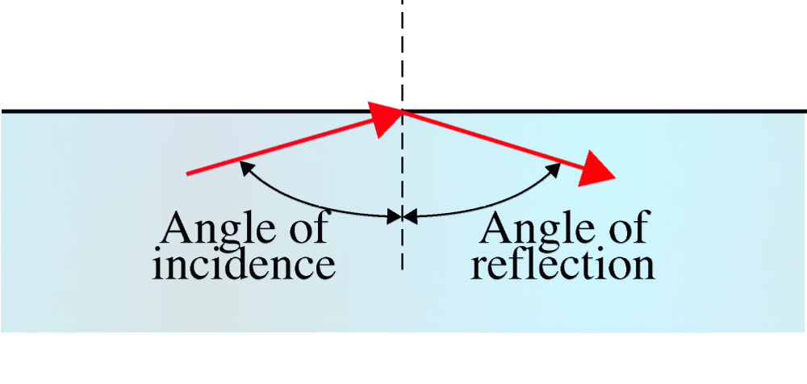
Figure 7-15
Light is captured!

Slide 25
Total Internal Reflection
Optical fibre uses reflection to guide light through a channel
Glass or plastic core is surrounded by a cladding of less dense glass or plastic.
Aim is to get …..
T.I.R

Slide 26
The difference in density of the two materials must be such that a beam of light moving through the core…
is reflected off the cladding instead of being refracted into it.

Slide 27
Modes = Paths
Information is encoded onto a beam of light as series of 0n-off flashes that represent 1, 0
2 modes for propagating light along optical channels
Multimode
Single mode
Each requires fibre with different physical characteristics

Slide 28
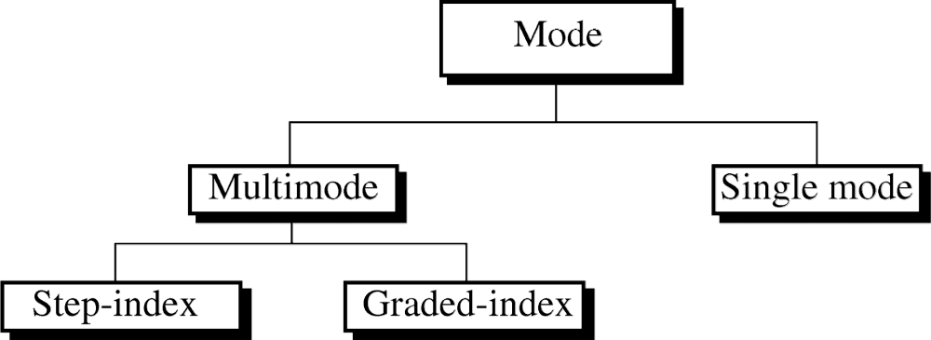

Slide 29
Multimode
Named because of the multiple beams from a light source move through the core in diff. paths
2 types
Multimode step index
Multimode graded –index
The fibre core has a refractive index slightly higher than the cladding material
Remember light is confined by TIR

Slide 30
Multimode step index
The greater the angle of incidence the greater the angle of reflection.
Beam with smaller angle of incidence will require more bounces to travel same distance as beam with large angle of incidence.

Slide 31
Different beams arrive at the destination at different times. (NOT GOOD)
This distortion limits the available data rate
This type of cable is inadequate for certain precise applications.

Slide 32
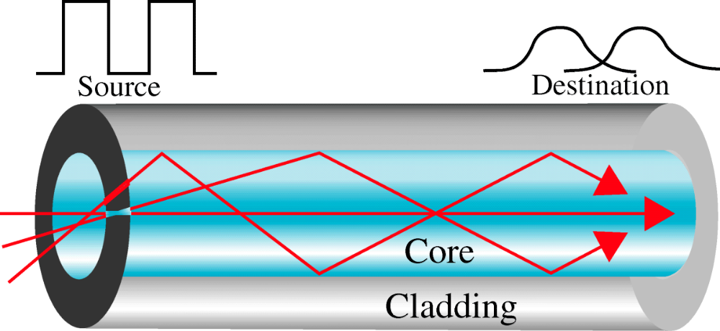
Figure 7-17
Multimode Step-Index

Slide 33
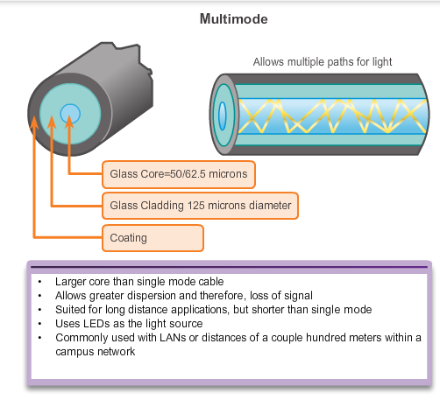

Slide 34
Multimode graded index
Unlike the abrupt change in step index the transition is gradual.
The refractive index of the core drops gradually from the centre of the fibre to the edge of the cladding
Density is highest at the centre of the core and decreases gradually to the lowest at the edge.
Each density difference causes each beam to refract into a curve.

Slide 35
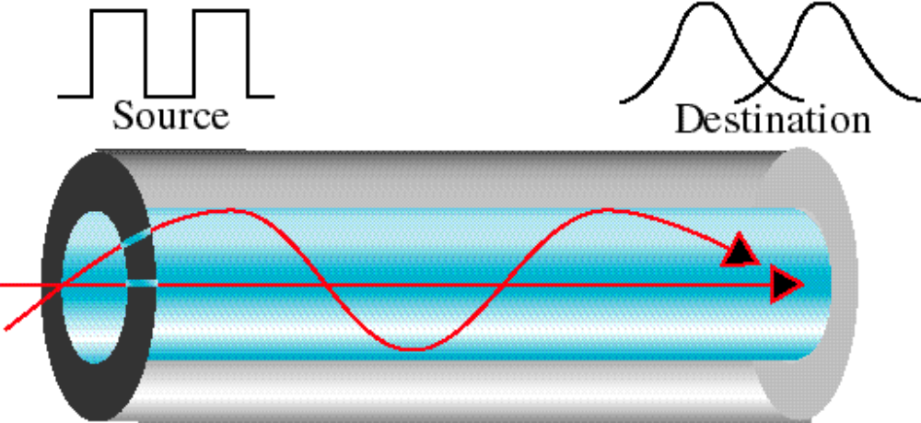
Multimode Graded-Index

Slide 36
Modal Dispersion
Multimode fibre typically uses LED emitters that do not create a single coherent light wave.
Instead, light from an LED enters the multimode fibre at different angles.

Slide 37
Modal Dispersion
Because light entering the fibre at different angles takes different amounts of time to travel down the fibre…..
Long fibre runs may result in the pulses becoming blurred on reception at the receiving end.
This effect, known as modal dispersion, limits the length of multimode fibre segments.

Slide 38
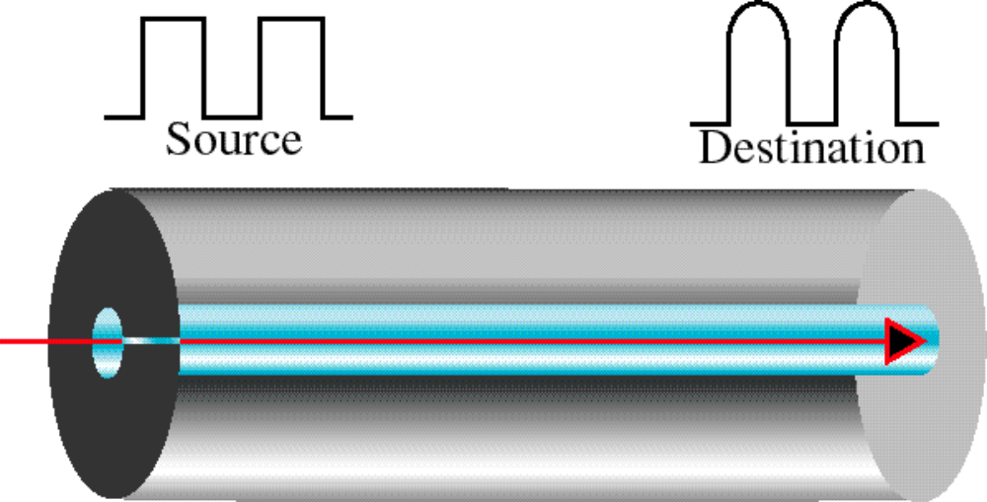
Single Mode

Slide 39
Single mode
Single mode uses step index fibre and a highly focused source of light
This focused source limits beams to a small range of angles
All close to the horizontal
Manufactured with a much smaller diameter
Lower density
Decrease in density results in a critical angle that is close enough to 90

Slide 40
Makes propagation of beams almost horizontal.
Propagation of different beams is almost identical and delays are negligible.
All of the beams arrive at the destination “together”….
can be recombined without distortion to the signal

Slide 41
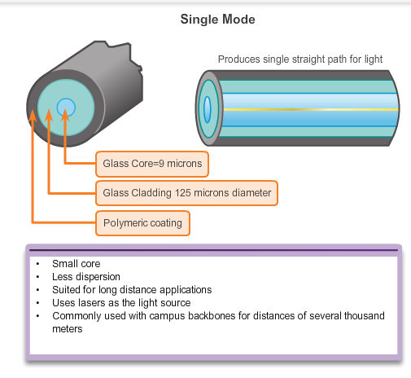

Slide 42
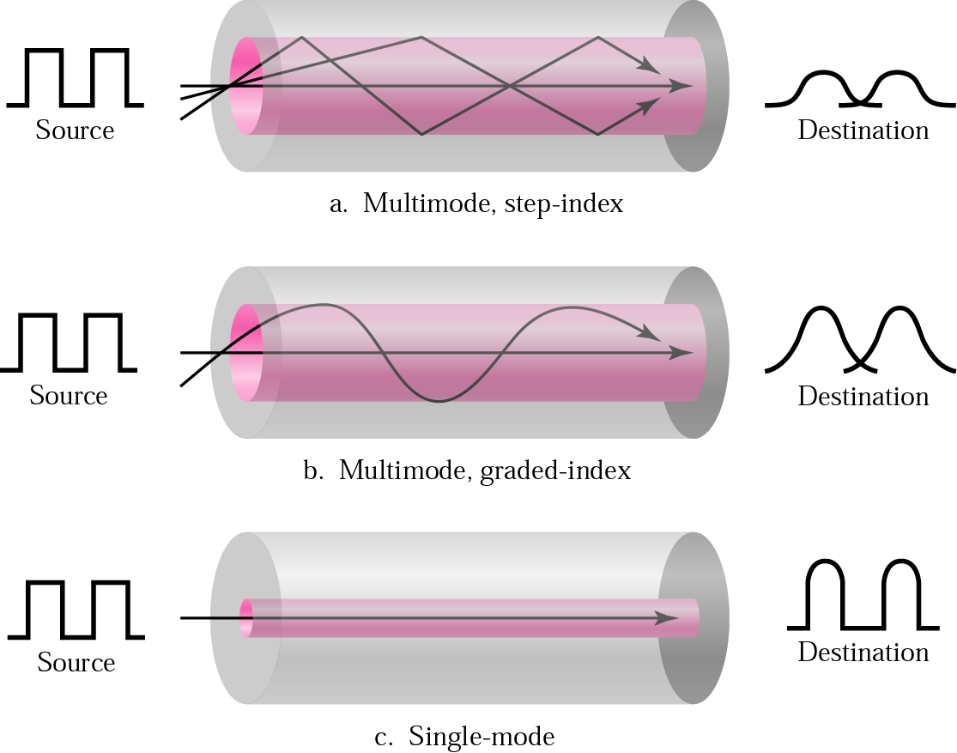
Figure Recap Modes

Slide 43
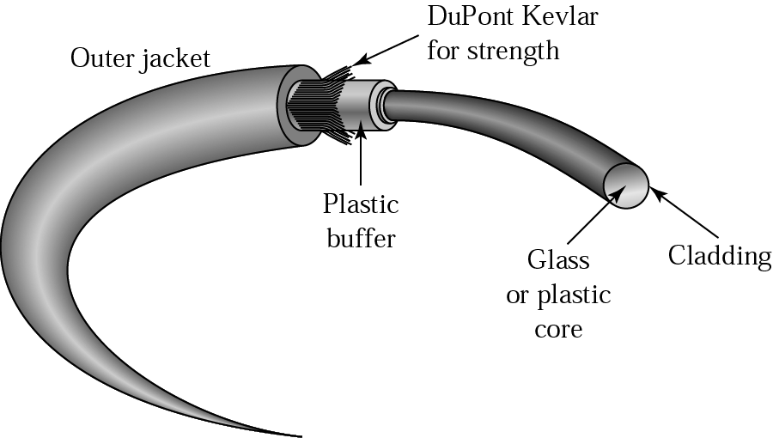
Fibre Construction

Slide 44
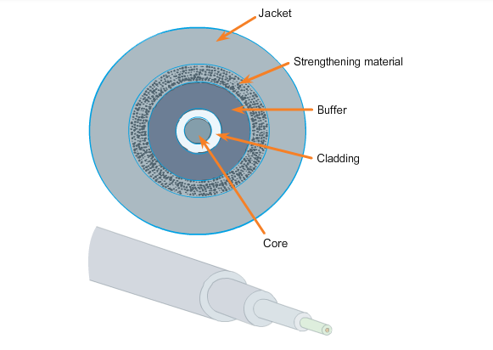
Fibre Construction

Slide 45
Fibre Construction
Although an optical fibre is very thin, it is composed of two kinds of glass and a protective outer shield.

Slide 46
Cable composition
Core surrounded by cladding
Fibre covered by a buffer layer to protect it from moisture
Core and cladding must be of different densities
Inner core = ultrapure
Outer jacket can be made of Teflon, fibrous plastic, metal mesh
Choice of material depends where the cable is used

Slide 47
Fibre Construction
Core: Consists of pure glass and is the part of the fibre where light is carried.

Slide 48
Cladding
Cladding: The glass that surrounds the core and acts as a mirror.
The light pulses propagate down the core while the cladding reflects the light pulses.
This keeps the light pulses contained in the fibre core in a phenomenon known as total internal reflection.
TIR

Slide 49
Jacket
Typically a PVC jacket that protects the core and cladding.
It may also include strengthening materials and a buffer (coating) whose purpose is to protect the glass from scratches and moisture.

Slide 50
Although susceptible to sharp bends, the properties of the core and cladding have been altered at the molecular level to make it very strong.

Slide 51
Optical fibre is proof tested through a rigorous manufacturing process for strength at a minimum of 100,000 pounds per square inch.
Optical fibre is durable enough to withstand handling during installation and deployment in harsh environmental conditions in networks all around the world.

Slide 52
Fibre sizes
Optical fibres are defined by the ratio of the diameter of their core to the diameter of their cladding.
Both expressed in microns
Common sizes:
62.5/125 (core, cladding) (micro) x-6
50/125
100/140

Slide 53
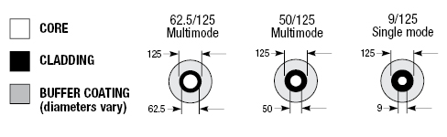

Slide 54
Fibre Types
Type | Core | Cladding | Mode
50/125 | 50 | 125 | Multimode, graded-index
62.5/125 | 62.5 | 125 | Multimode, graded-index
100/125 | 100 | 125 | Multimode, graded-index
7/125 | 7 | 125 | Single-mode

Slide 55
Fibre Connectors
The three most popular network fibre-optic connectors include:
Straight-Tip (ST): An older bayonet style connector widely used with multimode fibre.

Slide 56
SC
Subscriber Connector (SC):
Sometimes referred to as square connector or standard connector.
It is a widely adopted LAN

Slide 57
LC
Lucent Connector (LC):
Sometimes called a little or local connector, is quickly growing in popularity due to its smaller size.
It is used with single-mode fibre and also supports multimode fibre.

Slide 58
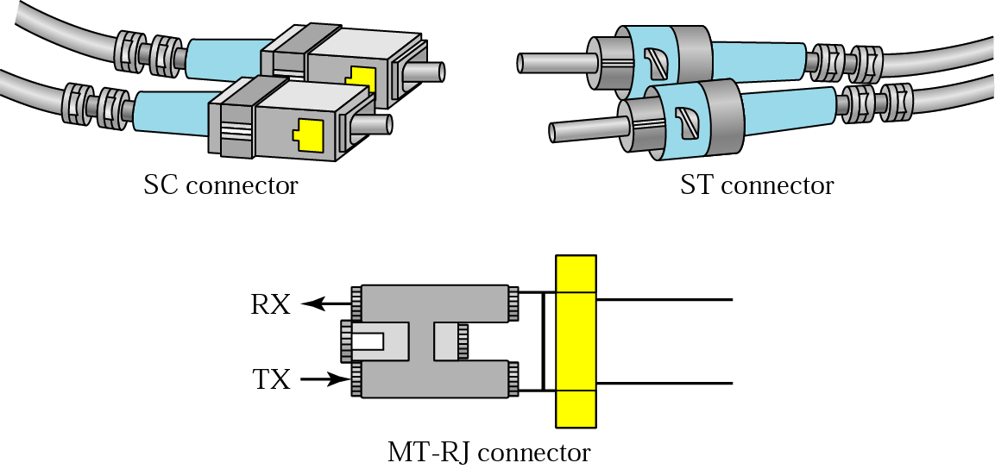
Fibre Connectors

Slide 59
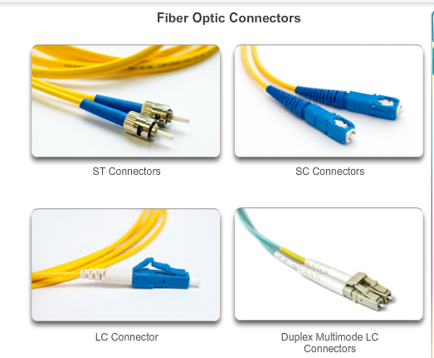

Slide 60
Because light can only travel in one direction over optical fibre, two fibres are required to support full duplex operation.

Slide 61
Therefore, fiber-optic patch cables bundle together two optical fiber cables and terminate them with a pair of standard single fiber connectors.
Some fiber connectors accept both the transmitting and receiving fibres in a single connector know as a duplex connector.

Slide 62
Fibre patch cords are required for interconnecting infrastructure devices.
SC-SC multimode patch cord
LC-LC single-mode patch cord
ST-LC multimode patch cord
SC-ST single-mode patch cord

Slide 63
Fibre cables should be protected with a small plastic cap when not in use.

Slide 64
Colours Standards again!
Colour is used to distinguish between single-mode and multimode patch cords.
The reason is because of the TIA-598 standard which recommends the use of a:
yellow jacket for single-mode fibre cables
orange (or aqua) for multimode fibre cables.

Slide 65
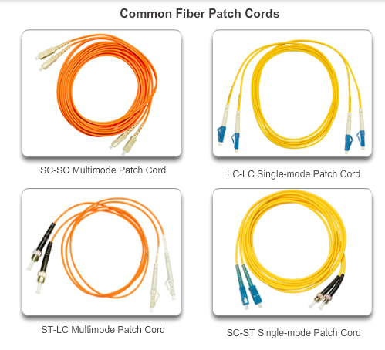

Slide 66
Light sources for optical fibre
Purpose is to contain and direct a beam of light from source to target
Source must be equipped with a light source
Receiving device with a photo sensitive cell
Two types of sources:
LED
Lasers

Slide 67
LED:
Cheaper, unfocused, diffuses over distance, limited to shorter distances
Lasers:
Focused, narrow range, character of signal preserved over considerable distance.

Slide 68
Major factors concerning light sources
Light source wavelength
Spectral width
Power
Modulation…
Attenuation and dispersion are functions of the wavelength

Slide 69
Advantages
Noise resistance
Less signal attenuation
Higher bandwidth

Slide 70
Noise resistance
Because fibre-optic transmission uses light rather than electricity
Noise is not a factor
External light, the only possible interference
Is blocked from the channel by the outer jacket

Slide 71
Less signal attenuation
Fibre-optic transmission distance is significantly greater than that of other guided media.
A signal can run for miles without requiring regeneration

Slide 72
Higher bandwidth
Fibre optic cable can support dramatically higher bandwidths than either twisted pair or coaxial cable
Currently, data rates and bandwidth utilization over fibre optic cable are limited not by the medium but by the signal generation and reception technology available.

Slide 73
Disadvantages
Cost
Installation/ maintenance
Fragility

Slide 74
Cost
Fibre-optic cable is expensive
Because any impurities or imperfections in the core can throw off the signal
Manufacturing must be painstakingly precise
Also a laser light can cost thousands of euros
compared to hundreds of euros for electrical signal generators

Slide 75
Installation/maintenance
Any roughness or cracking in the core of an optical cable diffuses light and alters the signal
All splices must be polished and precisely fused
All connections must be perfectly aligned and matched for core size.
Must provide a completely light tight seal
Metallic media connections, can be made by cutting and crimping using relatively unsophisticated tools. (as we know)….

Slide 76
Terminating and splicing fibre-optic cabling requires special training and equipment.
Incorrect termination of fibre-optic media will result in diminished signalling distances or complete transmission failure.

Slide 77
Splicing Errors
Three common types of fibre-optic termination and splicing errors are:
Misalignment: The fibre-optic media are not precisely aligned to one another when joined.
End gap: The media does not completely touch at the splice or connection.
End finish: The media ends are not well polished or dirt is present at the termination.

Slide 78
Fragility
Glass fibre is more easily broken than wire
Making it less useful for applications where hardware portability is required.
But this has improved significantly.

Slide 79
What to know???
Advantages and disadvantages??
Applications??
Differences between multimode and single mode???
Illustrate differences in modes
TIR, critical angle….

Slide 80
